Slide 1
Managerial Economics and
Organizational Architecture Chapter 9: Economics of Strategy: Game Theory

Slide 2
Game Theory
Managers must put themselves in their rival’s shoes
Determine how rivals will respond to your actions
Assume
all decision agents are rational
each attempts to anticipate actions of rivals
non cooperative games is used in this chapter
294m.
Note 2 + 3
2

Slide 3
Game Theory
https://www.facebook.com/classictvmoments/videos/100000-steal/2294216330611721/
3

Slide 4
Simultaneous-Move, Non-Repeated Interaction
Simultaneous
Rivals must make decisions without knowledge of each other’s decisions
Non repeated (in the beginning)
The interaction occurs only once
4

Slide 5
Example
Boeing and Airbus individually choose and simultaneously choose price (high or low) for 10 planes (p. 296ø.)
Each cell represents the payoffs
A dominant strategy is one the firm chooses no matter what its rival does.
5

Slide 6
Strategic Form, Dominant Strategy
Airbus
Airbus Low Price
Airbus High Price
Hvis den ene virksomhed sætter en høj pris og den anden sætter en lav pris, går ordren til virk-somheden med den lave pris
Hvis begge sætter enten høj/høj eller lav/lav pris, deles payoff
$500
$1000
Boeing Low Price
$500
$0
Boeing
$0
$750
Boeing High Price
$1000
$750
6

Slide 7

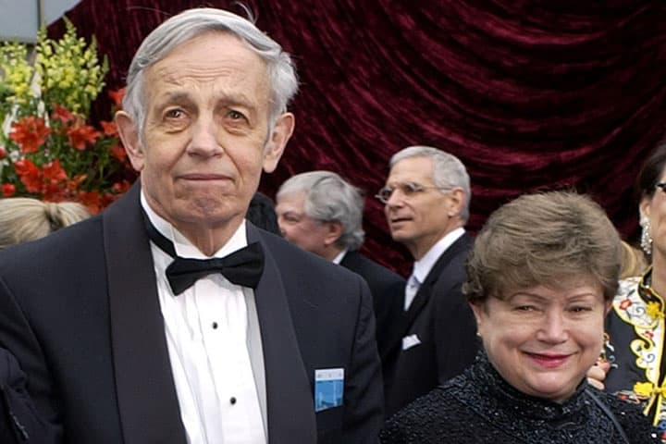
Nash Equilibrium, revisited
In the absence of a dominant strategy (remember, a dominant strategy is one the firm chooses no matter what its rival does), a Nash equilibrium may predict outcome:
A Nash equilibrium is a set of strategies where a firm does its best given rival’s actions
Use circle technique to identify Nash equilibrium…. (or do whatever you like)
Kilde: https://www.imdb.com/title/tt0268978/
Kilde: https://www.wbur.org/onpoint/2015/05/29/beautiful-mind-game-theory-john-nash-death
7

Slide 8
Nash Equilibrium
Airbus
Airbus Low Price
Airbus High Price
Jf. s. 206 + 299m.
4
$500
$1000
Boeing Low Price
$500
$0
Airbus har en dominerende strategi (low price)
Boing har ikke!
1
Boeing
3
$600
2
$750
Boeing High Price
$1000
$750
8

Slide 9
Nash Equilibrium
This is a stable outcome
No firm has an incentive to make another choice…..
When dominant strategies exist, firms have strong incentives to choose them.
A Nash Equilibrium is more likely to occur when rivals have good information about potential payoffs.
Ramme p. 300ø. og 300m.
9

Slide 10
Competition Versus Cooperation
Boeing and Airbus make simultaneous choices of new communication systems
two technologies: Alpha & Beta
Boeing and Airbus both benefit with same choice
Results in two Nash equilibria
benefits from pre-commitment communication
10

Slide 11
Coordination Game: Two Nash Equilibria
Airbus Alpha
Airbus
Airbus Beta
$100
$50
Boeing Alpha
$100
$50
Boeing
$50
$100
Boeing Beta
$50
$100
11

Slide 12
Coordination/Competition Game
Airbus Alpha
Airbus
Airbus Beta
$100
$40
Boeing Alpha
$50
$40
De to virksomheder er interesserede i at vælge éns (A,A eller B,B), men har forskellige præferencer!
Boeing
Boeing Beta
$25
$50
$25
$100
11

Slide 13
Sequential Interactions
Boeing & Airbus communications technology choice
Boeing chooses first
Analyze with backward induction
Boeing must take Airbus’s best response into account in making its choice
Boeing has first mover advantage
Credible commitment by second mover can change first mover choice (but talk is cheap!)
13
307n.

Slide 14
Extensive Form Sequential Game – backward induction
If Boeing chooses Alpha,
Airbus chooses Alpha
Boeing 100
Alpha
Airbus 50
Airbus
Beta
Alpha
Boeing 40
Airbus 40
Boeing
Boeing 25
Alpha
Airbus 25
Beta
Airbus
Beta
If Boeing chooses Beta,
Airbus chooses Beta
Boeing 50
Airbus 100
14

Slide 15


Repeated Strategic Interaction
Strategic choices can come to incorporate more than short-term payoffs
The cooperative outcome is more likely if
Long-run gains from cooperating are greater than short-run gains from not cooperating (surprise)
The expected length of the relationship is long
Kilde: https://www.haz.de/lokales/hannover/hannovers-coolste-wg-kueche-wohngemeinschaft-aus-linden-gewinnt-gilde-partypaket-TC5EHROIYVE4ZNTXZTVMD4YQ5E.html
15
Kilde: https://www.genialetricks.de/abwasch-fehler-vermeiden-a-a/63741678909197

Slide 16
Strategic Interaction, Organizational Architecture and Principal/Agency - relationships
Game theory pulled into an organizational context:
Kiana (principal) manages Lenin (agent)
Len must choose between working and shirking
Kiana must choose whether to incur monitoring costs or not
No pure strategy equilibrium exists
A labor contract including incentive compensation (not just fixed salary) may solve this problem (kap. 15)!
16

Slide 17
Mixed Strategy (randomization, 0,5)
Shirk
Len
Doesn’t shirk
Ramme p. 313ø., 314n. & 315n.!
Tallene viser ‘net payoffs’:
Kiana vil helst ikke monitorere.
Len vil helst shirke!
Hvis Len arbejder, vil Kiana ikke monitorere.
Hvis K. ikke monitorerer, shirker L.
No pure-strategy eq.
Mixed strategy eq. with random 0,5.
-$5
$15
Doesn’t monitor
$15
$10
Kiana
$0
$10
Monitor
$5
$10
17

